Slide 1
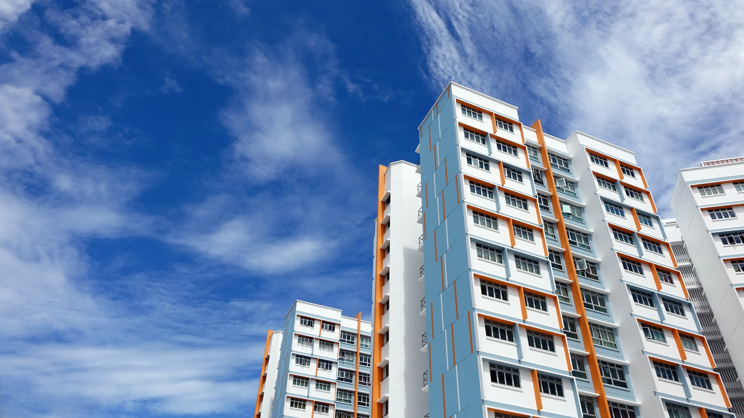
Singapore housing data set challenge
An analysis by Gabriel Kok

Slide 2



Introduction
Singapore: Second Most Expensive Housing Market
Huge Variability in Price: 71 one-million dollar HDBs sold in 2018
What makes a HDB expensive?
Notes:
Background: Singapore has second most expensive housing markets in the world, despite 85% of Singaporeans living in government provided public HDBs.
There is huge variability in HDB resale prices, they can go from as low as 250k to over 1 million. In fact, 71 HDBs were sold over 1 million in 2018
What makes a HDB expensive? Well known drivers of price are: staying in central location, larger floor area, premium type of HDBs, higher storeys, ect

Slide 3

The Data
Data.gov.sg
Variables
Date Sold (Year and Month)
Town
Flat Type
Block and Street Name
Storey Range
Floor Area Sqm
Flat Model
Lease Commence Date
Remaining Lease
Target Variable
Resale Price
Stats
>840,000 rows 1990---2021 Mar 9 features
Notes:
Obtained from data.gov.sg
9 variables
From 1990 to 2021 Mar (present)
Over 840,000 rows

Slide 4
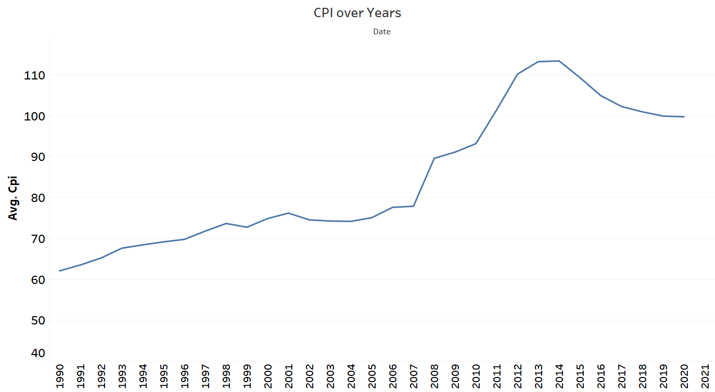

Data Cleaning
Transform Resale Price -- Real Price
CPI per month for housing and utilities data (singstat)
Allow us to compare true value of price between different time periods
Notes:
On the right we see the average CPI over the years has been changing quite rapidly, especially after 2008

Slide 5
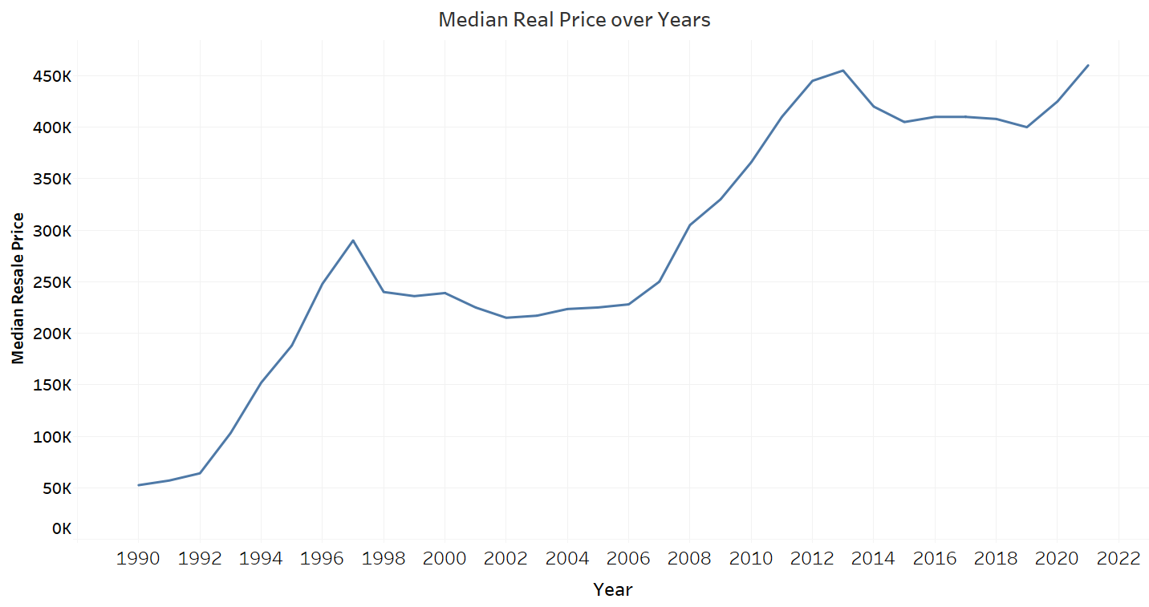
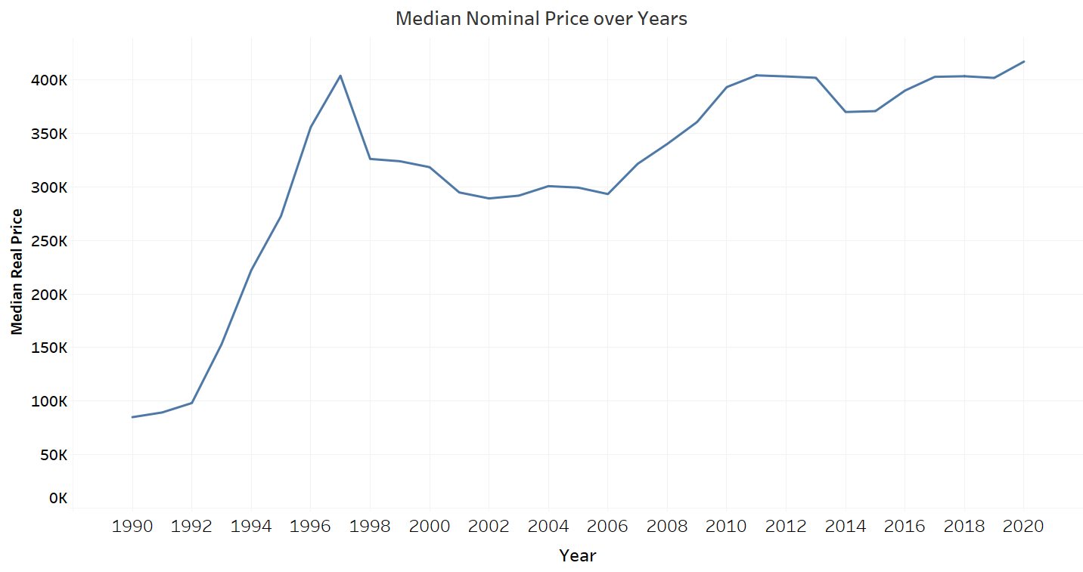
Data Cleaning
Median Resale Price Over Years
Before Adjustment
After Adjustment
Notes:
The trend is roughly the same, but individual values for each year are quite different.

Slide 6
Exploratory data analysis

Slide 7
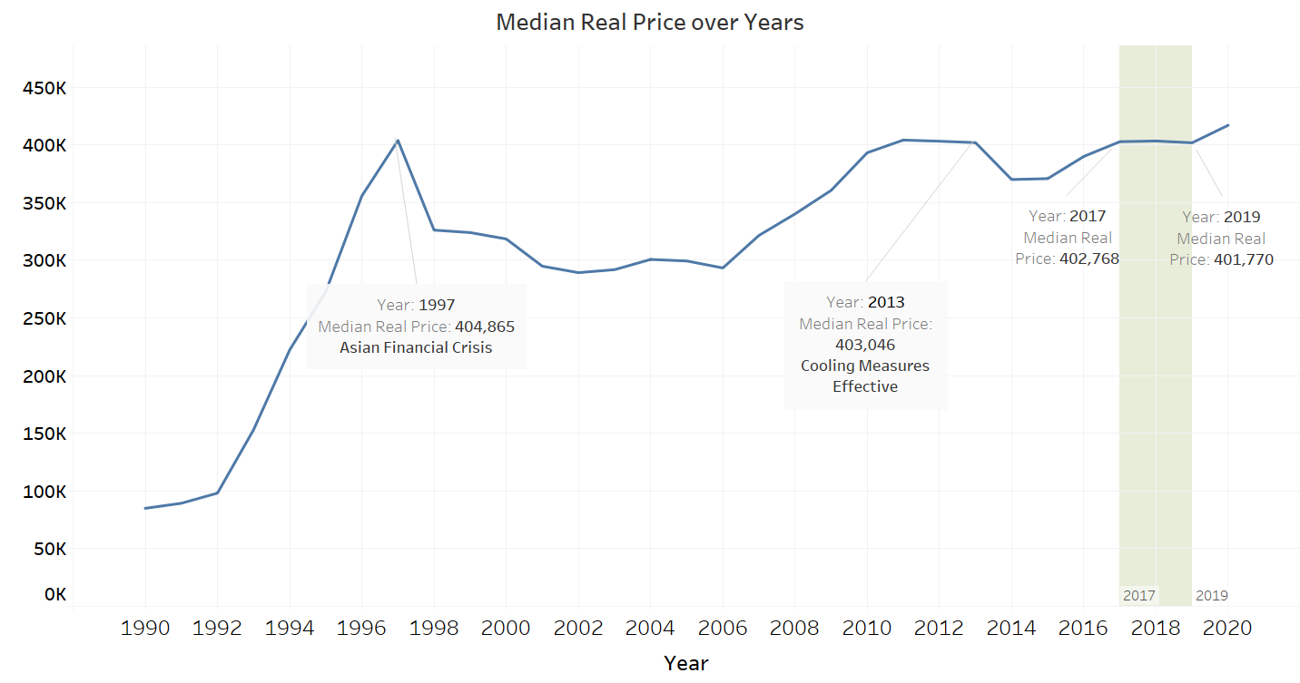
Prices stable between 2017 and 2019
Median Price Over Years
Notes:
We plot the Median Real Price over time for the entire time period. We observe that price has been fluctuating for most of this time period.
The sharp descent from 1997 coincides with the Asian Financial Crisis, causing house prices to fall. Since 2006, it starts to gradually rise till 2013 where it drops again, due to MAS implementing cooling measures.
Between 2017 and 2019, prices are relatively stable. The amount of variation is only about $1000. In order to better understand the effect of other factors of housing price, we shall study price only in this time period. Also, this time period is most recent, so it reflects the current reality.

Slide 8
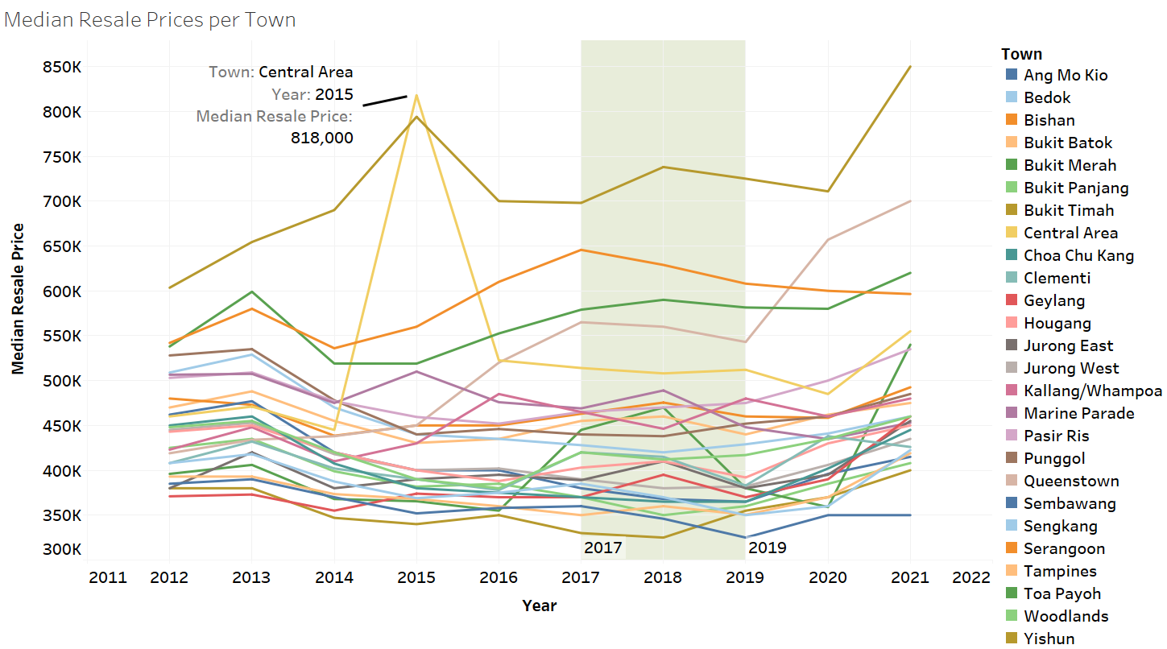
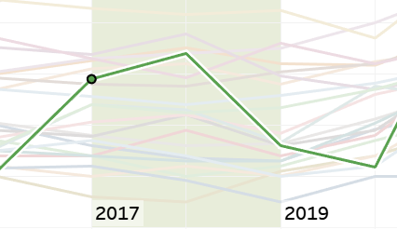
Median Price - Town
Toa Payoh
Notes:
Between 2017 and 2019, median prices within each town are relatively stable as well, with the exception of Toa Payoh. (dropped from 470k in 2018 to 380k in 2019)
No large spikes and falls in the prices for each town, such as that of the Central Area between 2014 and 2016, where median price rose by almost half in one year, fell back down to near original by the next year.
These stable prices will allow us to better study the effects of the various drivers on housing prices.

Slide 9
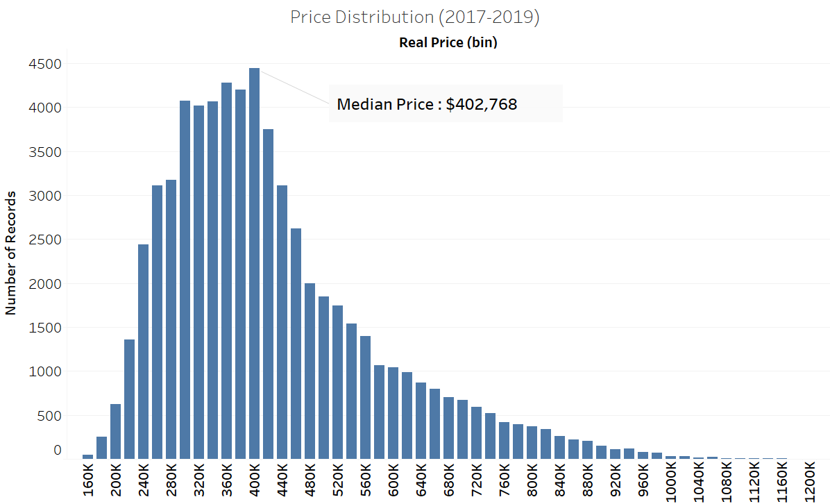
Real Price Distribution
Median Price
$402,768
Notes:
The distribution is quite skewed to the right, with a long right tail. The median value is about 400k.

Slide 10
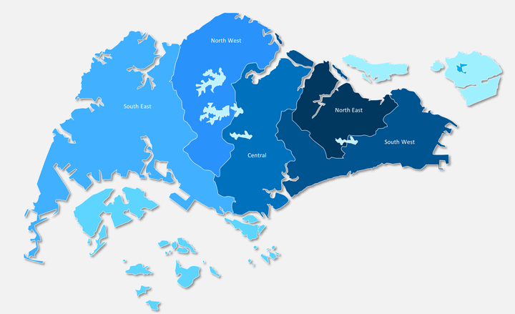
North
Median: $350,837
PSF: $3,588
North-East
Median: $414,365
PSF: $4,283
West
Median: $372,955
PSF: $3,786
East
Median: $421,519
PSF: $4,266
Central
Median: $490,138
PSF: $5,496
Region Ranked | Median | PSF
Central | $490,138 | $5,496
East | $421,519 | $4,266
North-East | $414,365 | $4,283
West | $372,955 | $3,786
North | $350,837 | $3,588
Notes:
Since there are many towns, I grouped them into the 5 regions of Singapore for easier visualisation
PSF is closely tied to Median price

Slide 11
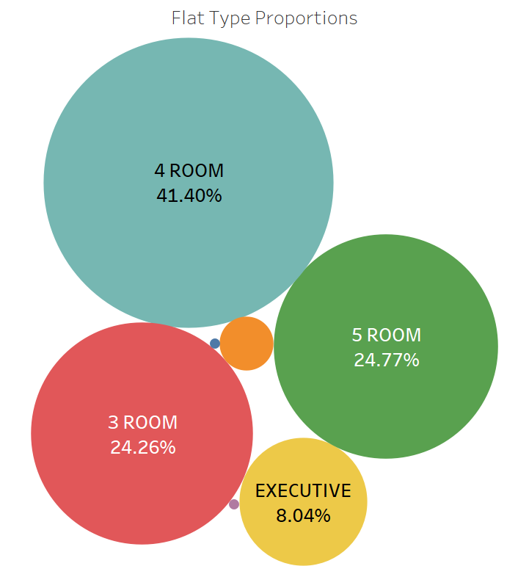
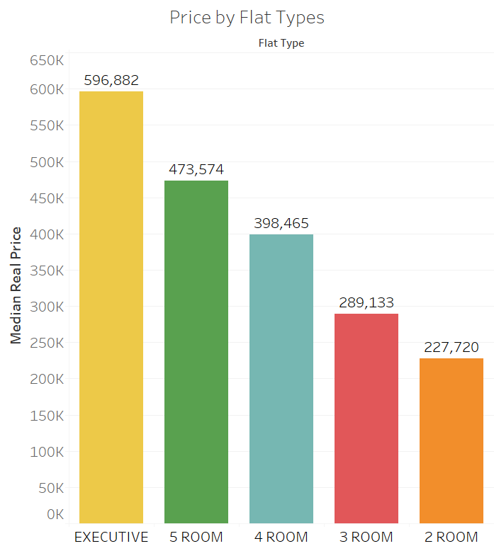
FLAT TYPES (Number rooms)
2 room
1.43%
Notes:
We can see median price increases steadily as number of room increases, which is to be expected.
Both 1 room and multigeneration flats(blue and purple circles) account for only 0.05% of records, hence, we will exclude them.

Slide 12
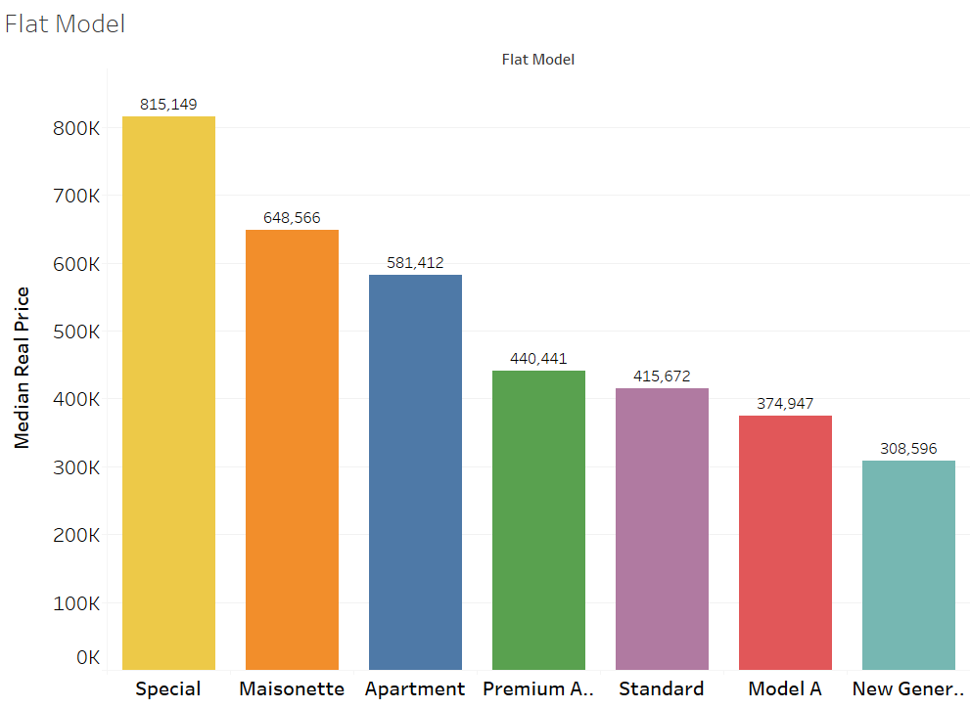
Flat Model
Model A Maisonette
Improved Maisonette
Premium Maisonette
Maisonette
Maisonette
Terrace
Adjoined Flat
Type S1
Type S2
DBSS
Special
Model A2
Model A
Simplified
Model A
Premium Apartment Loft
Apartment
Apartment
Notes:
We regroup the 18 different type of flat models into 7 new categories. They were grouped based on similar housing types.
Special –type contains Type S1S2, DBSS, all premium, award winning design flats known for their high prices. Terrace and Adjoined Flats are naturally larger flats, so higher price too.

Slide 13
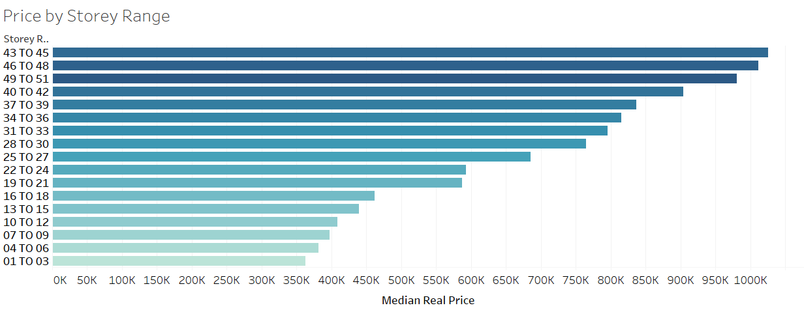
Storey Range
Notes:
Generally, price increases the higher the storey range. The increase in price per storey range is actually quite linear.

Slide 14
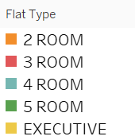
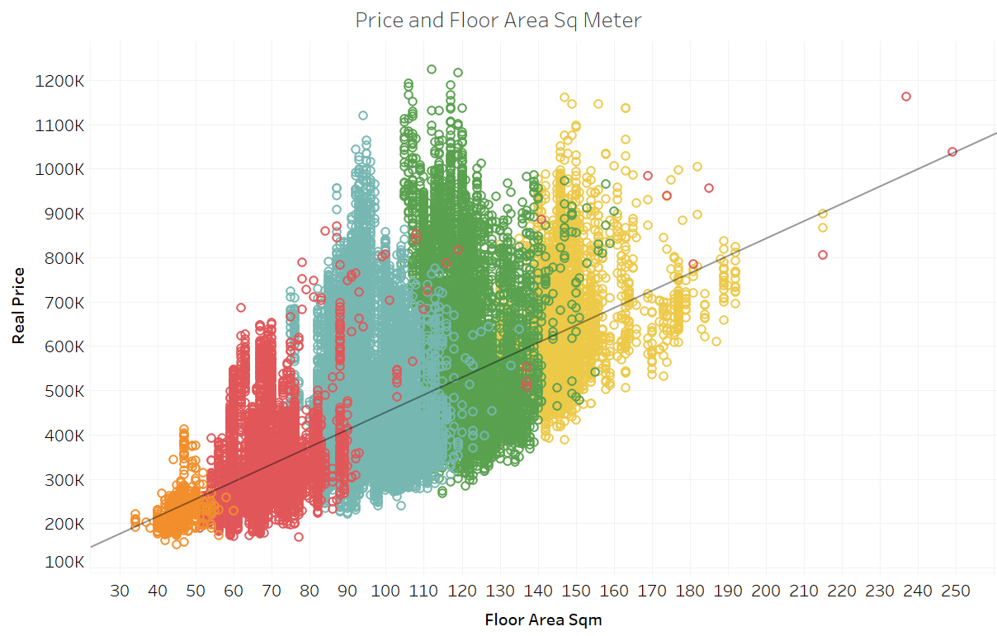
Floor Area
3 room
Adjoined Flat
3 room
Adjoined Flat
Notes:
Plotting a scatterplot with floor area over Real price, we see there is a strong positive correlation between floor area and real price. This is expected in our densely populated Singapore, as land area is scarce and thus the floor area highly contributes to overall house price.
The color indicates the number of rooms or flat type. Generally, we see that as number of room increases, the floor area will also increase. We can also see a few outliers that we should check out.
After checking, these outliers are actually adjoined-flats which are 2 flats combined. However, they are still labelled as ‘3 room’ flat type.

Slide 15
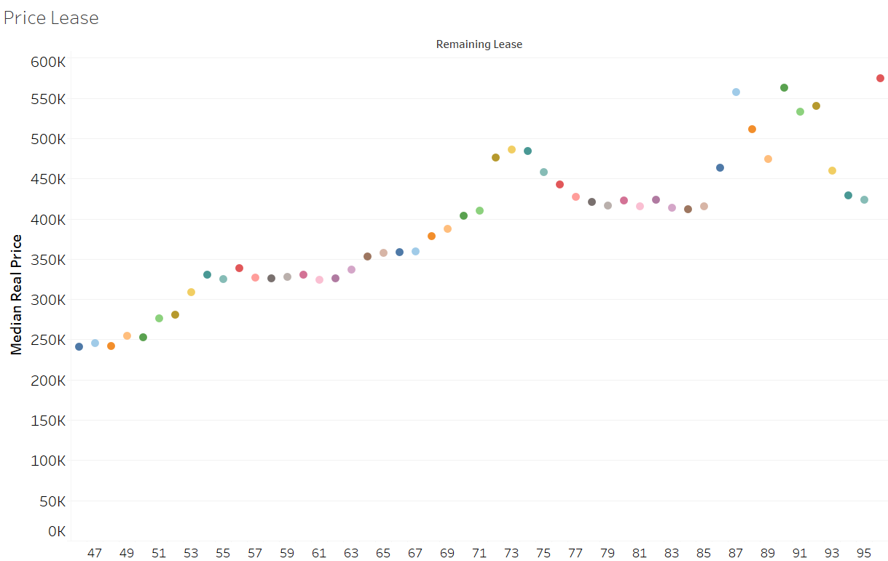
Remaining Lease
Notes:
There is also a strong correlation between lease years left and median sale price.
. There seems to be a large increase in median price after 85 years. However, the prices are very volatile between each year within that period, in contrast to the stable yearly trend before the 85 year mark.

Slide 16
Feature engineering
Notes:
We try to create new features using our present data, as well as data taken from external sources.
I feel it is interesting to see how a house distance to different amenities like supermarkets, MRT stations, can affect the final price.

Slide 17



Data
Features
Block Number
Distance to nearest Amenity
Street
Unique Address
OneMap.sg
API
Function to obtain distances
Amenities Addresses
Schools
Supermarkets
Hawker Centres
MRT Stations
Raffles Place MRT
Number of Amenities within 2km radii
Get coordinates
(excluding Raffles Place MRT)
Notes:
We want to find out if housing price affected by their proximity to various amenities.
For each house, we combine Block Number and Street to get the exact Address,
The data on the various amenities were obtained from data.gov.sg.
Onemap.sg api was used to retrieve the coordinates , which were then fed through other functions such as Geopy to obtain distance between 2 locations.
The output is for each unique address, we have Distance to nearest amenity, and number of that amenity within 2km radii from the address.

Slide 18
Flat | Nearest School | School dist | Num school 2km | Nearest Hawker | Hawker dist | Num hawker 2km | Nearest MRT | Mrt dist | Num mrt 2km
302 UBI AVE 1 | Maha Bodhi School | 0.214919641 | 5 | Blk 4A Eunos Crescent | 1.181131406 | 9 | UBI MRT STATION | 0.215147266 | 10
101A LOR 2 TOA PAYOH | Kheng Cheng School | 0.263901055 | 13 | Blk 93 Toa Payoh Lorong 4 | 0.287251407 | 6 | BRADDELL MRT STATION | 0.096223032 | 7
689A WOODLANDS DR 75 | Greenwood Primary School | 0.598400261 | 18 | Chong Pang Market & Food Centre | 2.647964374 | 0 | ADMIRALTY MRT STATION | 0.87803641 | 2
658C JURONG WEST ST 65 | Frontier Primary School | 0.091421576 | 16 | Taman Jurong Market & Food Centre | 2.355161531 | 0 | PIONEER MRT STATION | 0.35643256 | 2
Notes:
Here is a sample of the data obtained. Here we have 3 amenities, schools. Hawkers and MRT stations. Not shown here is the Supermarkets and Distance to Raffles MRT

Slide 19
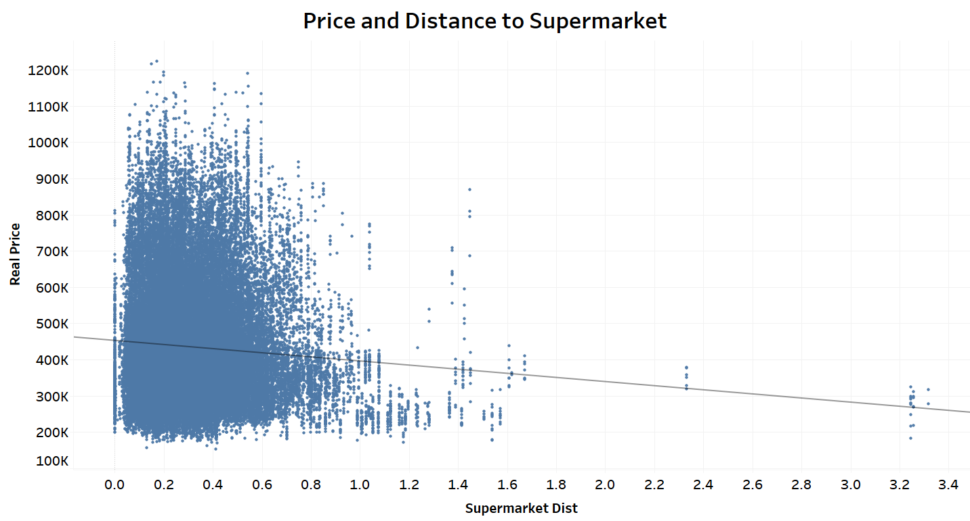
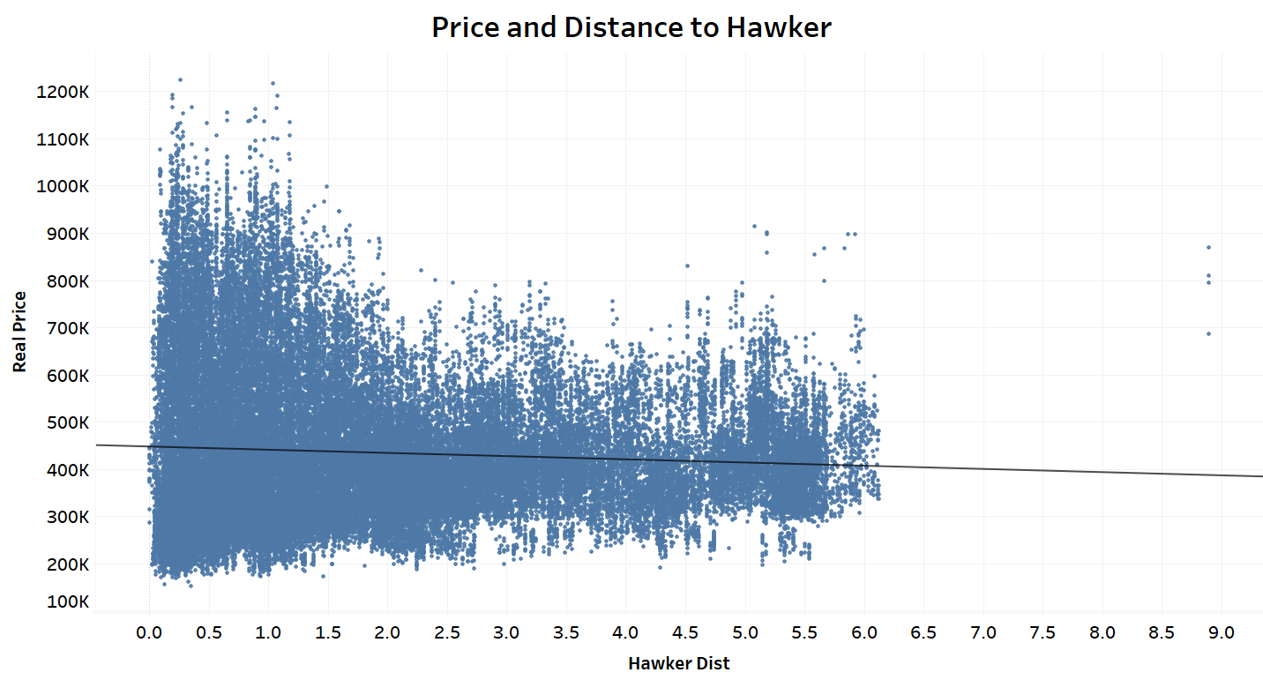
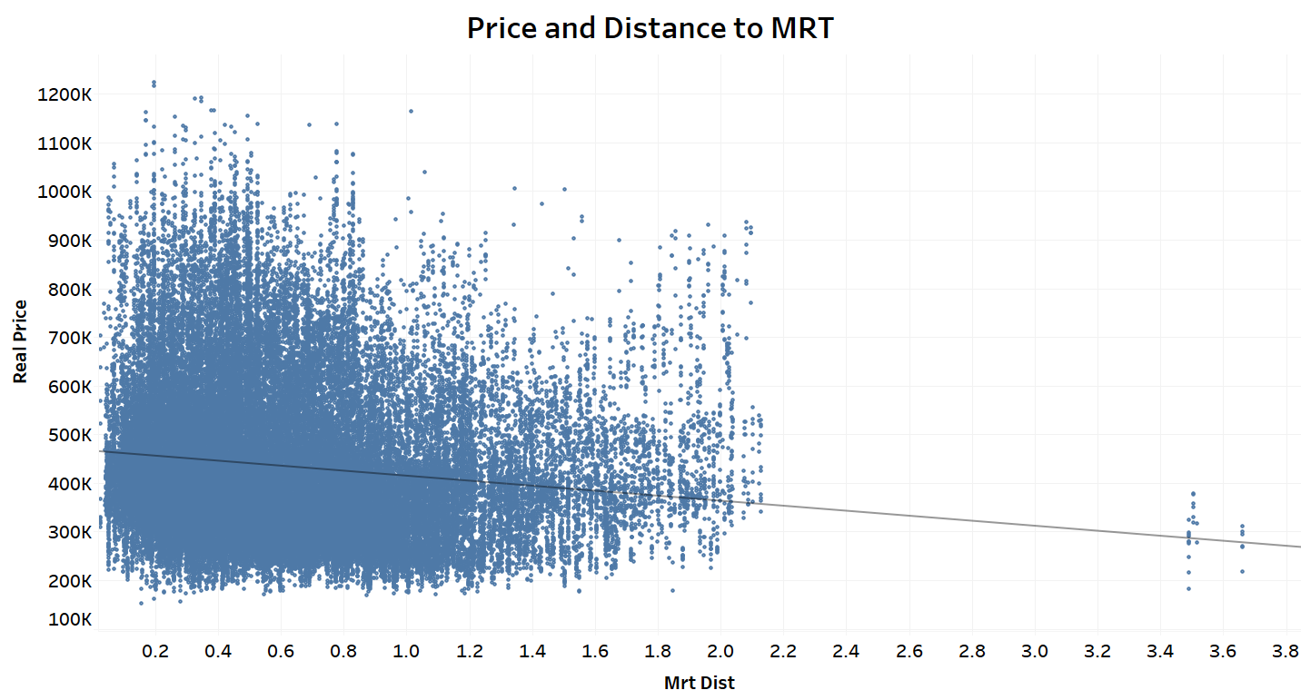
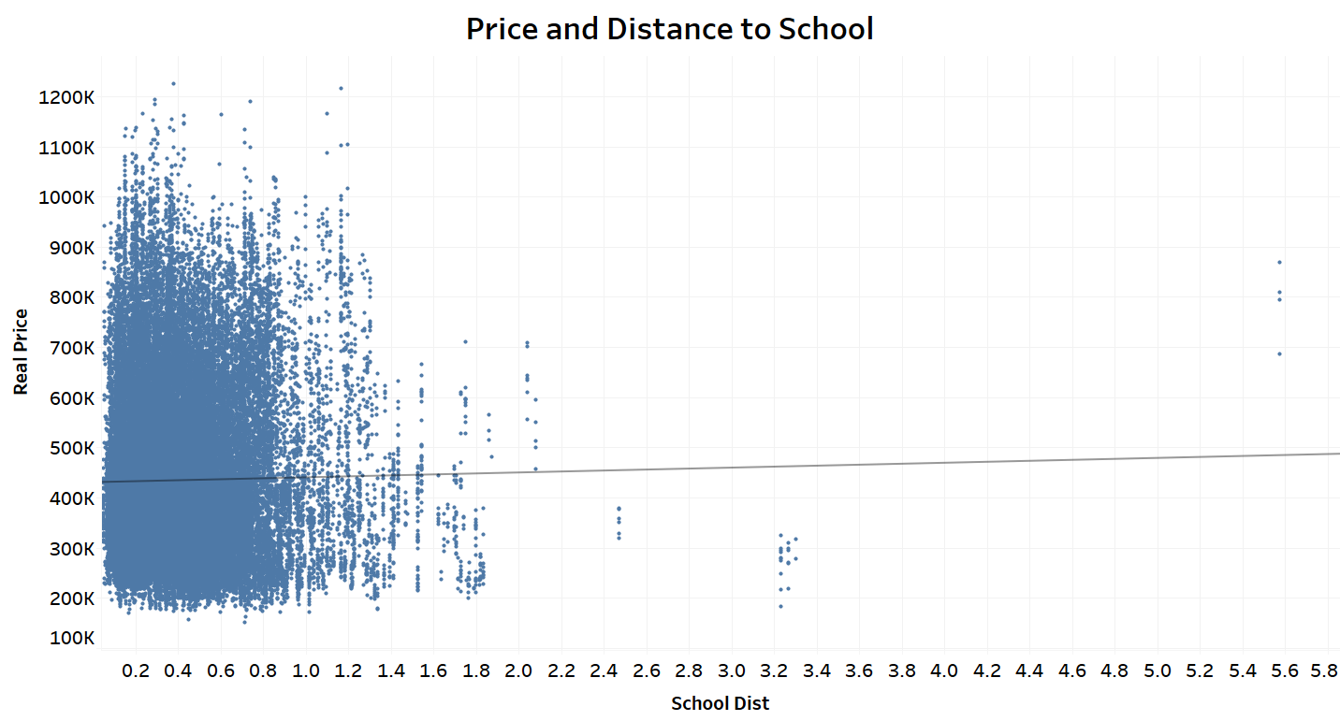
Distance Supermarket
Distance Hawker
Distance MRT
Distance School
Notes:
After getting the new features, we plot each of them against Median Sale Price.
There seems to be a downwards trend for the Nearest Supermarket, MRT and Hawker Center where the greater the distance, the lower the sale price. The trend seems to be stronger for Distance to MRT and Supermarkets.
However, the price trend seems to be upwards for school.

Slide 20
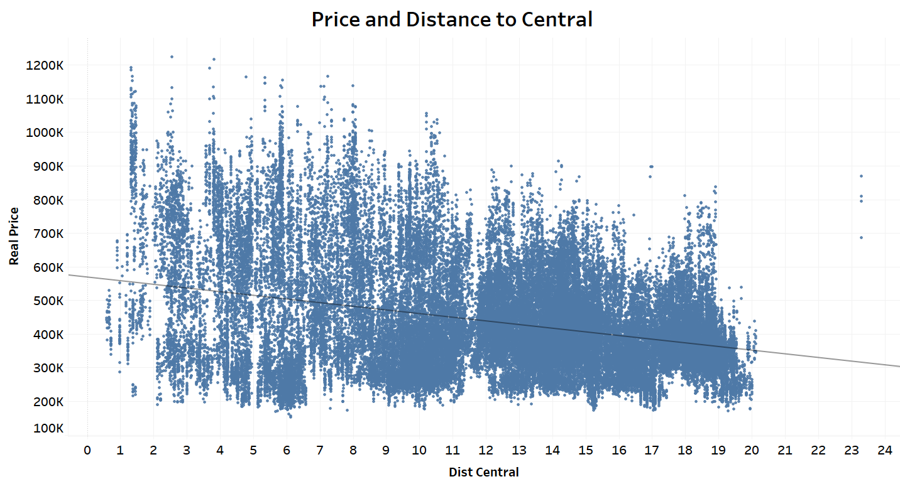
Notes:
As for Distance to Central, there is a clear negative trend.

Slide 21
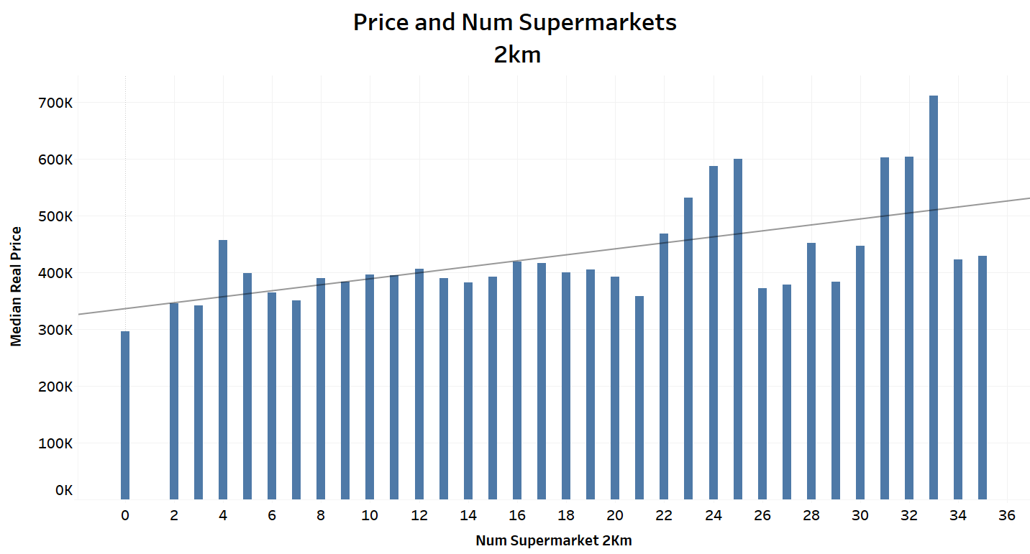
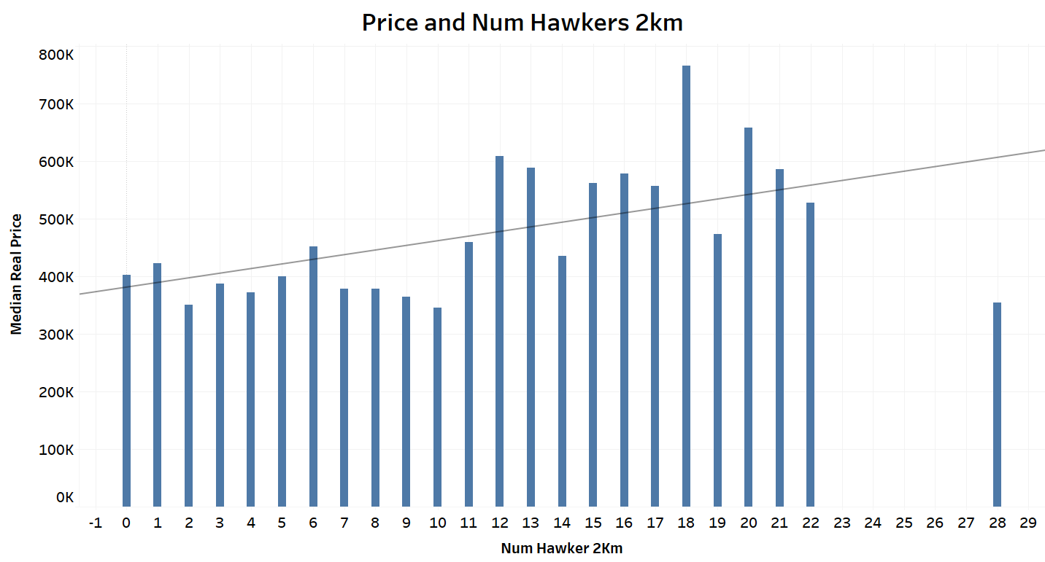
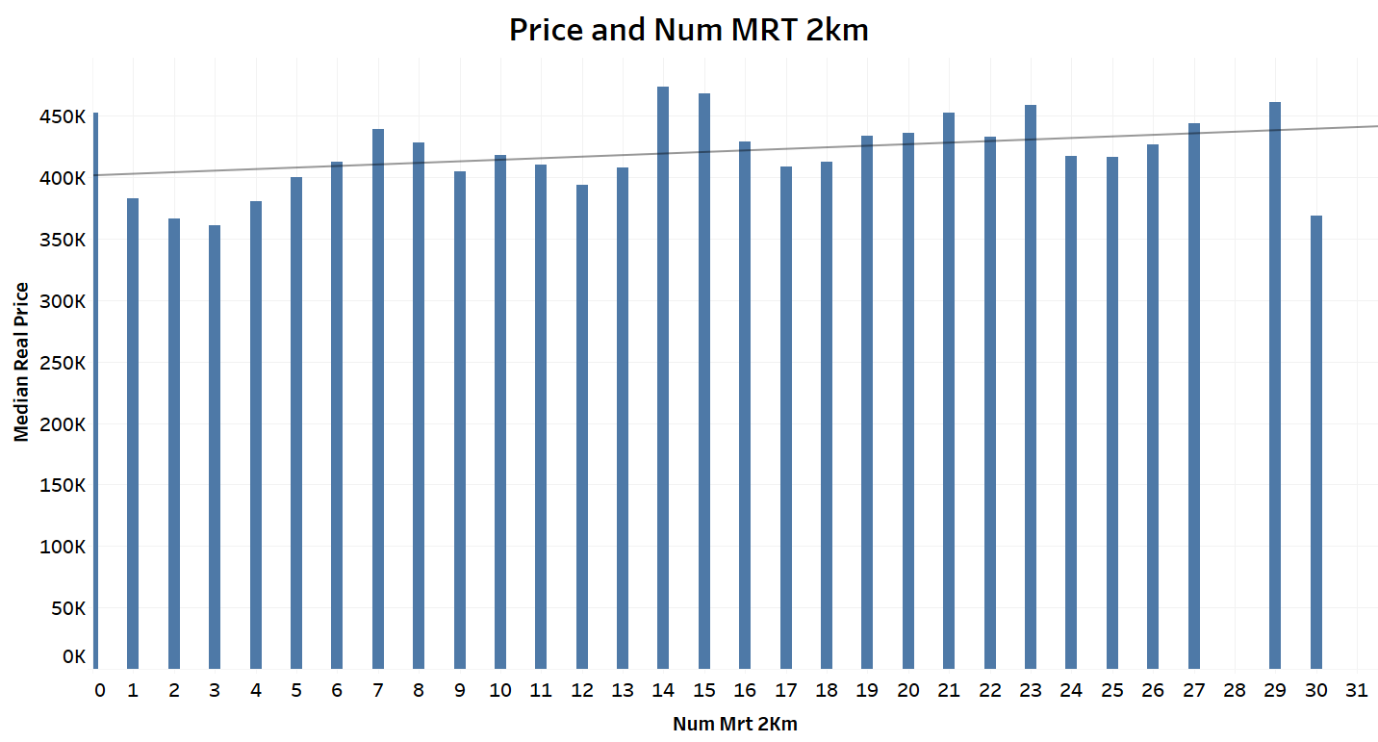
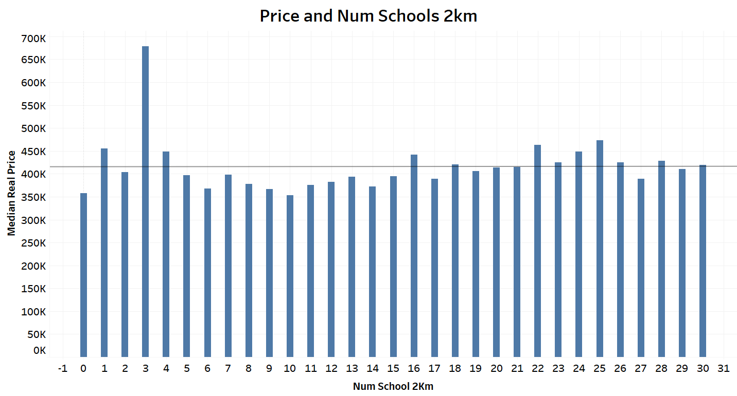
Number Supermarket 2km
Number Hawker Centre 2km
Number of amenities within 2km radii
Number MRT 2km
Number Schools 2km
Notes:
There seems to be a positive trend for Number of Supermarkets, hawkers and MRT within 2km.
Number of schools not much trend.

Slide 22
Model preparation
Notes:
So far, we have only looked at each individual variable against the target variable: Real price. We can see the trend between each of theses features and the Real Price, but we cannot fully measure its impact on the price. We don’t know how much each variable contributes to the overall price.
To quantify the impact of each variable, we need to come up with a Model that takes in these variable and predicts the output(price) as a function of these variables. Then, we can study the coefficients of each variable and conclude its impact on the price. We shall start with the most basic model: Linear Regression.

Slide 23
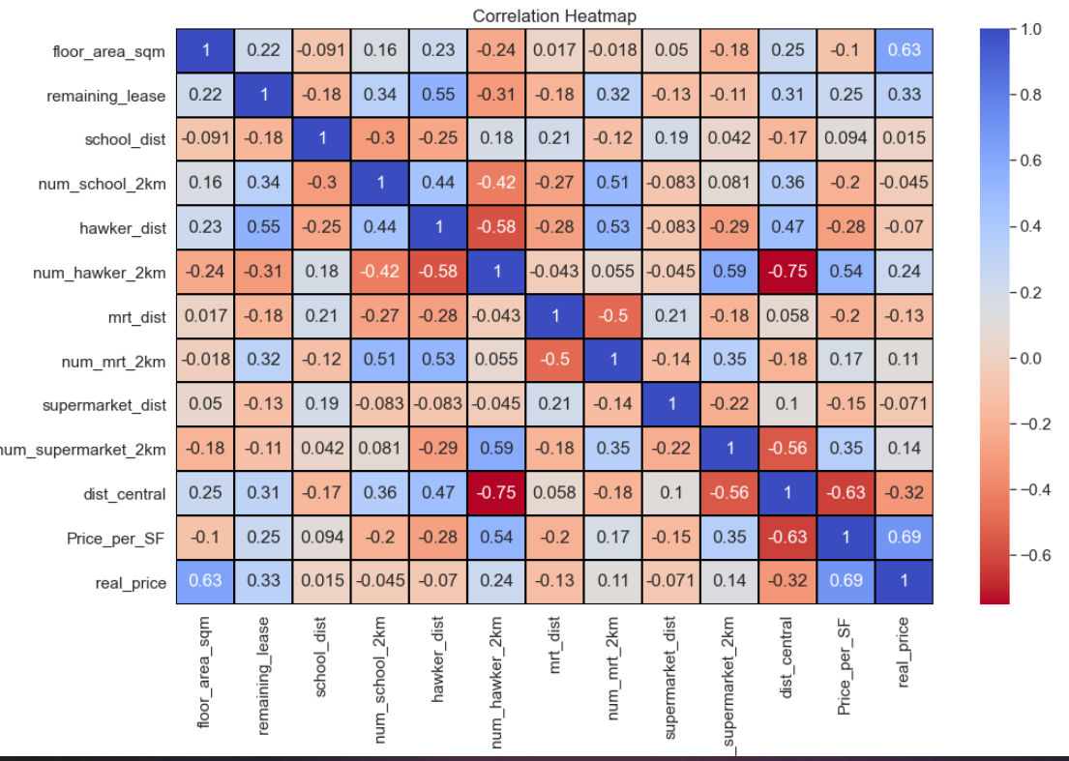
Notes:
In order to prepare the data for the model, we need to do a few things, the first it to identify multicollinearity. We need to remove variables with high multicollinearity, because otherwise it becomes difficult for the model to estimate the relationship between each independent variable and the dependent variable.
This is because for multicollinear variables, change in the value of one feature will also force change the value of other features.
So, we plot a correlation heatmap of the continuous variables. For example, we can see dist central and num_hawkers_2km has a pretty high collinearity. So we might need to remove them before training the model.

Slide 24
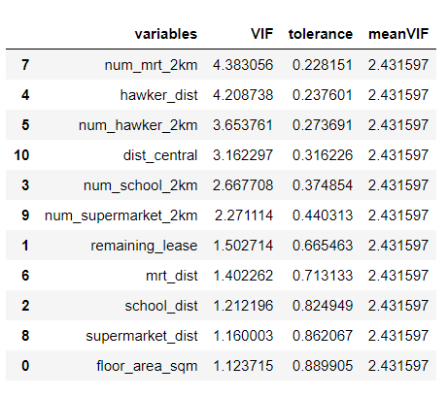
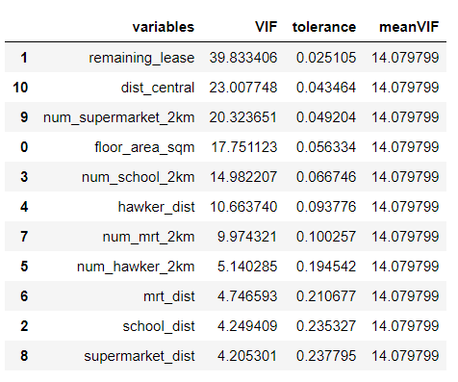
Variation inflation factors (VIF)
Feature scaling
New VIF
Initial VIF
Notes:
The other thing we can do is VIF (Variation Inflation Factors) to better identify variables with high multi corllinearity.
VIF starts from 1, meaning it has no correlation to the other factors. Until 5 is a good measure.
Initially, VIF for many of the variables are pretty high, after feature scaling, it is strongly reduced. Since highest VIF is less than 5, we have no need to remove any of the features.

Slide 25
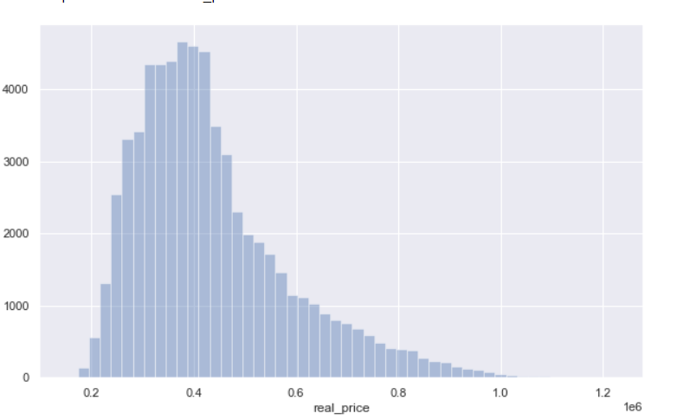
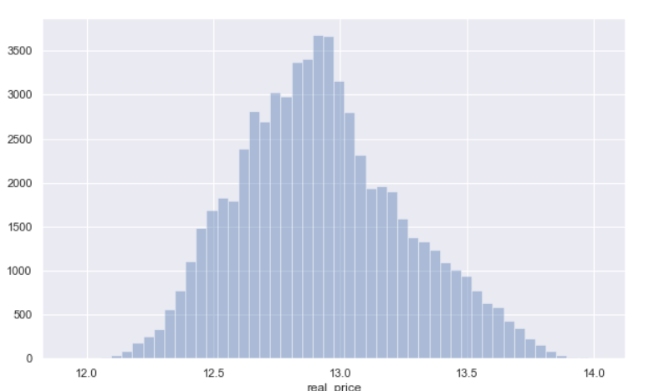
Model preparation
Log Transform Target(real price)
Get Dummies for Categorical Variables
Before
Region
Flat Model
Baseline: North Region
Baseline: Standard Model
Label Encode Ordinal Variables
After
Storey Range
Flat Type

Slide 26
Model Results

Slide 27
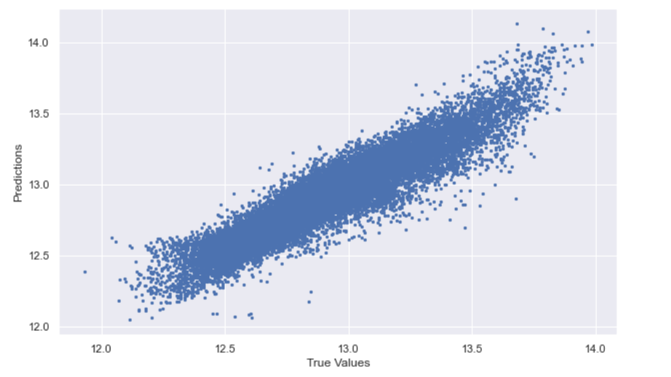
Linear Regression
Predictions vs True Values
Intercept: 12.66
R-square value: 0.877
Adjusted R-square value: 0.876
Notes:
Our Linear model performed quite well, with an R-square of 0.877. We scatter plot the model predictions against True Values, seems to be quite linear.

Slide 28
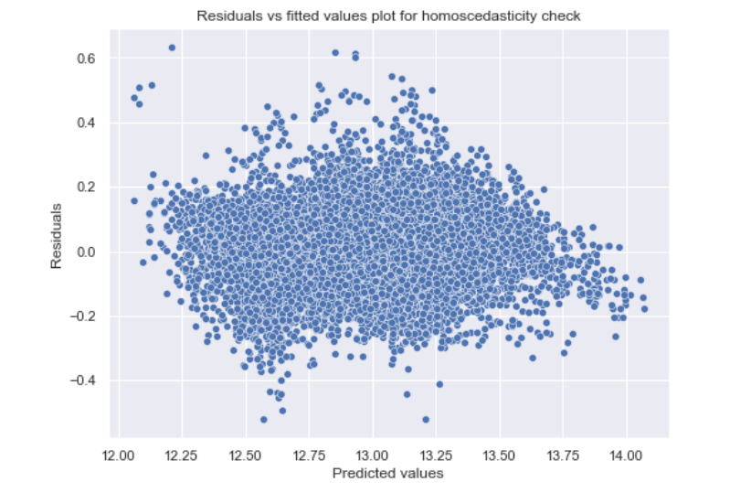
Assumptions Check
Mean of Residuals
Mean residuals: -0.000388
Homoscedasticity: Residuals against Predicted Values
Check for Homoscedasticity
plot does seem to show any definite trend
Goldfeld Quandt Test: Heteroscedasticity
'p-value', 0.893 >0.05
Cannot reject the null hypothesis
Conclude: error terms are homoscedastic
Notes:
We check whether key assumptions of linear model are satisfied. First, we look at mean value of residuals. It is -0.000388, which is very close to zero.
Next, we look at Homoscedasticity of the residuals. From the regression plot, the residuals seem to have similar variance across all the predicted values. Does not seem to have any definite trend, meaning residuals have equal variance.
We also apply the Goldfeld Quandt Test to check for heteroscedasticity(which is the opposite of homoscedasticity). Based on the p value of 0.893, we cannot reject null hypothesis, and conclude that error terms are homoscedastic.
Having satisfied these assumptions, we can now proceed to interpret the coefficients of our model.

Slide 29
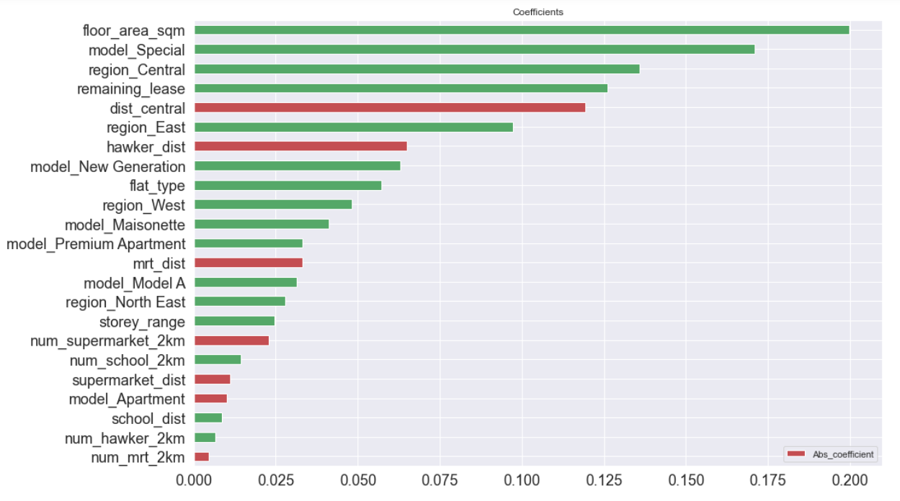
Coefficient Analysis
Strong Drivers
Notes:
We can use the value of the coefficients to compare their effects on Housing Price. The larger the absolute value, the greater the effect.
The green color indicates a positive relation, while the red indicates a negative correlation. As expected, most of the distance variables are negatively correlated, except for distance to school.

Slide 30
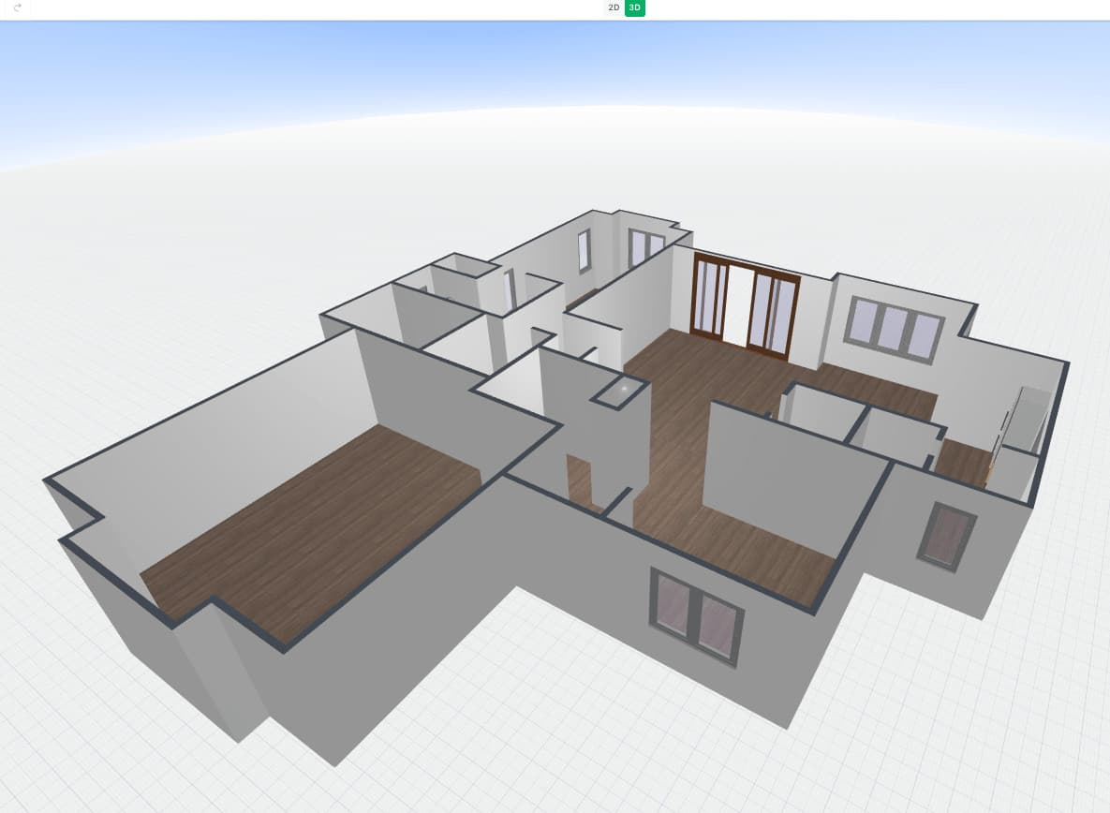
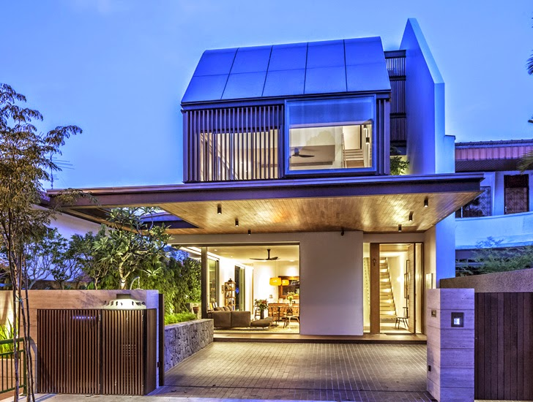
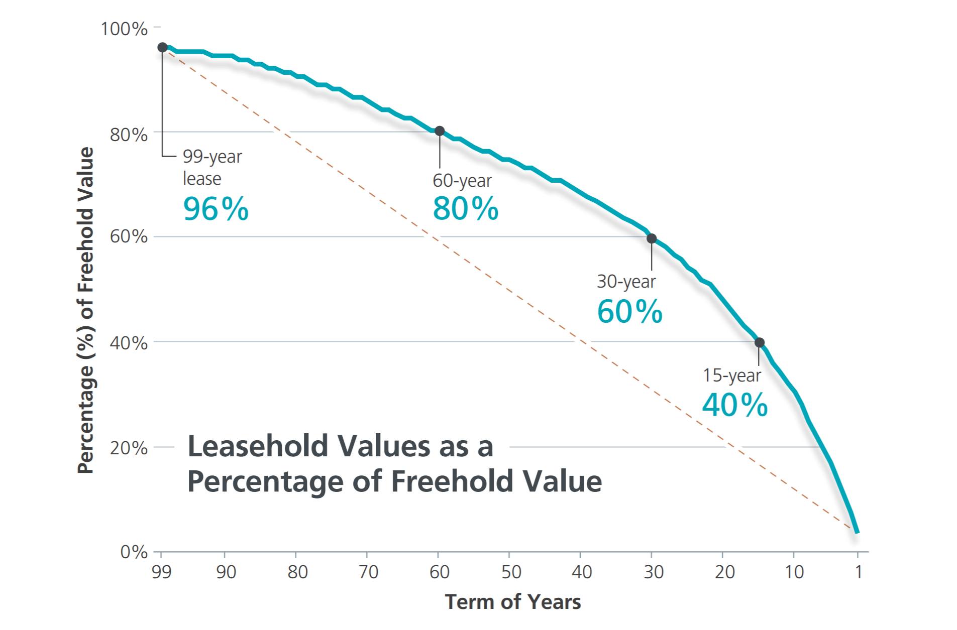

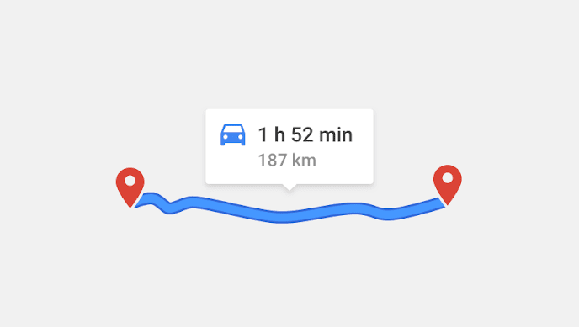
Strong Drivers: > 00.75 coefficient
1st Place:
Floor Area Square Meter
Value: 0.188
2nd Place
‘Special’ Flat Model
Value: 0.170
3rd Place
Located in Central Region
Value: 0.136
4th Place
Remaining Lease
Value: 0.126
5th Place
Distance to Central (Raffles Place MRT)
Value: 0.119
6th Place
East Region
Value: 0.0972
Notes:
The top feature is floor area sq meter. Demand for land area is very high, so every additional floor sqm results in a large increase in final price.
Coming in second is the flat model - 'Special' category. This category consist of naturally expensive, award winning design houses like DBSS, S1S2 as well as larger houses like adjoined and Terrace. ‘Standard’ model was used as a baseline. Thus, the choice of flat model heavily influences house prices.
In the third place is the Central Region factor. North Region was used as a baseline for comparison. This implies that houses in the central area are significantly more expensive than their North, counterparts. Central > East > West > North East.
Following that in 4th place, we have remaining lease years. Earlier, it was shown to have a strong correlation to price.
In the 5th place, we have distance to Central(Raffles Place MRT). However, it is likely there is some overlap between this factor’s effect on price, as well as ‘located in Central Area’ factor. Houses built in Central Area would consequently have short distances to Raffles Place MRT station.
6th place we have east region.

Slide 31
Moderate-weaker drivers
Moderate Drivers | Weaker Drivers
Region: East | Model: Model A
Hawker Distance | Number MRTs 2km
Model: New Generation | Number Hawkers 2km
Flat Type | School Distance
Region: West | Model: Apartment
Model: Maisonette | Supermarket Distance
Model: Premium Apartment | Number Schools 2km
MRT Distance | Number Supermarket 2km
Strong
Regions
Number of Amenities within 2km
House Models
Distance to school, supermarkets
Weak
Notes:
Distance to the other amenities like Supermarkets, Schools, MRT do not seem to be strong drivers of HDB prices. Only distance to Hawker is pretty strong.
Perhaps expensive houses are usually located further from amenities, since their buyers can afford cars anyway, so there is little additional inconvenience to them.
The number of amenities within 2km variables form most of the weak drivers, implying that having multiple amenities near the house does not impact price very much.

Slide 32

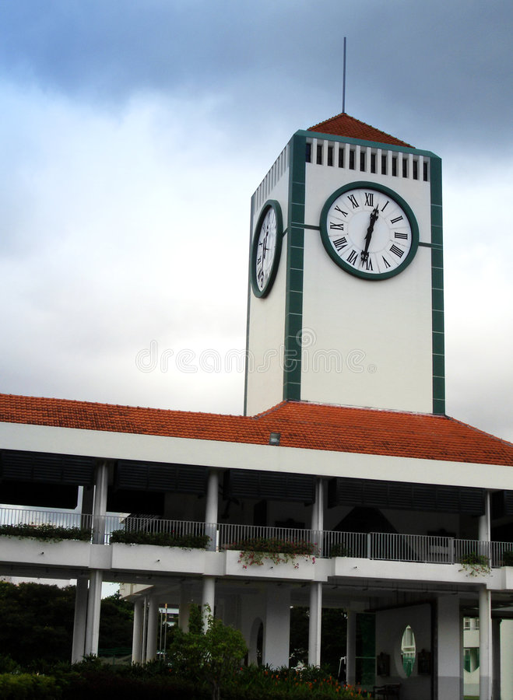
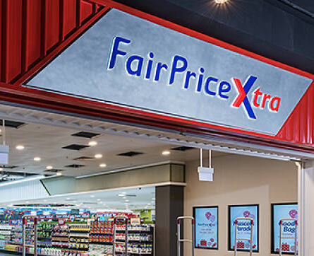
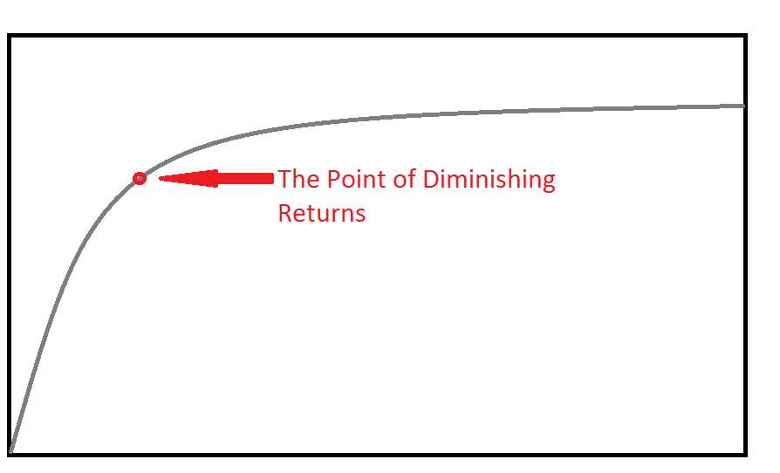
Number of Amenities within 2km
Numerical
Categorical
Number of Supermarkets
0 -4
5-10
>11
Value to Buyer
Number Supermarkets
Notes:
However, may not mean that these factors do not impact house prices.
A possible reason why they have low coefficients in this model could be due to a structural reason, or the way they are measured in the model. These variables likely follow a diminishing returns curve.
For example, there would be little increase in value to consumers as number available of Supermarkets increase past a certain point. The impact on price of the house would unlikely be linear.
A possible way to improve these variables coefficient, is to convert it to categorical variable, such as shown in the table. If we rerun the model, it might lead to a larger coefficient

Slide 33
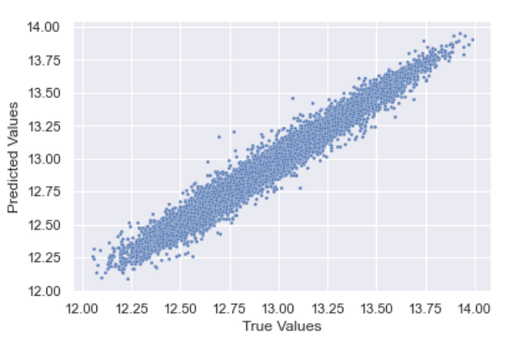
Random forest
Next, we fit Random Forest Regressor
Results:
OOB R2 Score: 0.965
Test Data R2 Score: 0.966
Test Data Mean Absolute Error: 0.045
Notes:
We use Random Forest Model. In contrast to the first linear regression model, it is non-parametric. It makes no assumption about the true functional form of the data, whether it is linear or non-linear, provides a good way to check the validity of our coefficients previously.
The R-square score achieved of 0.965 for OOB and 0.966 for Test Data is pretty good. From the scatter plot of predictions against true values, it looks quite accurate.
Limitation, did not tune model hyperparamters using cross validation, because of pc unable to run the code. However, since OOB score is relatively close, model is validated, ensure no overfitting.
Since our model performed fairly well, we can go ahead and look at the feature importances confidently.

Slide 34
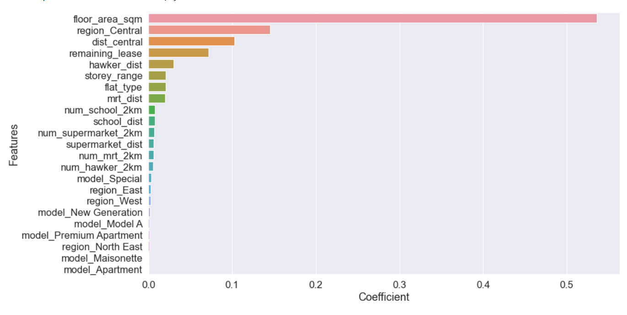
Random forest
Feature Importances
1.86%
Notes:
In random forest, feature importance. Even though it is a quick and convenient way of comparing features, it has a biased approach, and is prone to inflate the importance of continuous features. Because is measured in how much each feature reduces the impurity.
The feature coefficients are somewhat similar to that of the linear regression model. Floor area, central region, distance to central and remaining lease are still strong drivers of HDB price.
However, it is surprising to see that Model: Special has such as low coefficient, especially since it was in 2nd place in Linear Regression Model. This could be because the proportion of ‘Special’ models instances out o is very low, only 1.86%. So it does not contribute that much to reducing impurity.

Slide 35

Conclusion
Main Drivers of HDB Resale Price
1. Floor Area
2. Region: Central
3. Flat Model: Special
4. Remaining Lease
5. Distance to Central
6. Distance to Hawker

Slide 36
limitations
Only used 2 models: linear and random forest
Linear Model is a parametric, assumes a linear relationship between Price and each variable. However, in reality, rarely ever completely linear. Certain features like ‘Number of Amenities’ definitely do not follow a linear relationship
Data may not be enough to show impact of features (only 3 years of data)

Slide 37


Future directions
Feature Engineering
Data
Proximity to other Amenities (Shopping Malls, Nature Parks)
Compute Travelling Time
Population demographics
Environmental Condition(cleanliness, well constructed roads, ect)
Use more data from other time periods(eg. 2011-2013)
Recategorize Flat Models
Notes:
Include other amenities like large shopping malls
Compute travelling time with the use of public transport, instead of using distance
Filter out expensive houses like those in the Special category, and rerun the model, to see if the other distance coefficients like MRT, schools, supermarkets increase in importance.
Include data from other periods where price is stable: 2011-2013

Slide 38
Credits
Some ideas and methodology for this project were referenced from Teyang Lau, YooTimmy, leexa90
Github link:
https://github.com/teyang-lau/HDB_Resale_Prices
https://github.com/YooTimmy/HDB_Resale_Price_Study
https://github.com/leexa90/HDB-prices

